Slide 1


TRAFFIC CONGESTION
ANALYSIS & PREDICTION
Guide: DR. Y Lakshmi Prasanna
Team : 23
Ganesh Agarwal-2520090052
Vivek Vinnakota-2520090101

Slide 2

INTRODUCTION
Traffic congestion is a critical urban issue affecting travel time, road safety, and overall quality of life in cities worldwide.
• Rising vehicle volumes lead to frequent traffic jams and delays on urban roads.
• Analysis and prediction of congestion can significantly improve traffic management strategies.
• A real-world vehicle traffic dataset containing measures such as Vehicle Count, Speed, Weather, and Time of Day is used for exploratory analysis and prediction.
• Data-driven approaches can enable proactive and smarter traffic control.

Slide 3

PROBLEM STATEMENT
Traffic congestion is a growing urban challenge with wide-ranging consequences:
• Increasing Vehicle Volume
Rising number of vehicles on roads causes frequent and severe traffic jams, overwhelming existing road infrastructure.
• Lack of Predictive Insights
Conventional traffic management systems rely on reactive measures and lack data-driven predictive capabilities to anticipate congestion.
• Delays, Pollution & Accidents
Congestion leads to significant travel delays, increased fuel consumption and air pollution, and higher risk of road accidents — directly impacting commuters and city planners.

Slide 4



MOTIVATION
This project is driven by the growing need to address urban traffic congestion through data-driven approaches. Rising vehicle volumes in cities demand smarter, more proactive traffic management solutions.
• Real-world relevance due to rapidly rising urban traffic problems affecting daily commuters.
• Need for data-driven congestion prediction models to replace reactive systems.
• Supports city planning and traffic control improvements for safer, efficient roads.

Slide 5

PROJECT
OBJECTIVES
Analyze and predict traffic congestion levels using the vehicle traffic dataset to identify patterns and contributing factors.
Explore relationships between traffic factors (vehicle count, speed, density, weather) and congestion levels through statistical analysis.
Develop a basic predictive model framework and evaluate traffic patterns to support proactive traffic management decisions.

Slide 6


EXISTING SYSTEM
Current Approaches
• Manual monitoring by traffic officers at key junctions.
• Simple loop sensors and cameras for basic vehicle counting.
• Fixed-time traffic signals with no adaptive control.
• Limited real-time data sharing between intersections.
• Reactive management — action taken only after congestion forms.
Limitations
• Minimal use of data analytics or machine learning for prediction.
• Data sparsity due to incomplete or inconsistent sensor records.
• Delayed responses result in prolonged congestion periods.
• Lack of integration across city-wide traffic systems.
• No proactive or predictive congestion management capability.

Slide 7
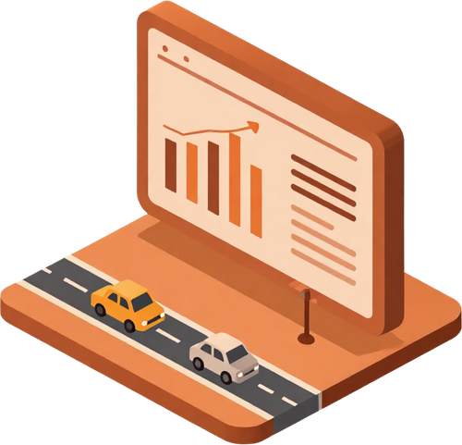

PROPOSED SYSTEM
Data Utilization
Utilize the vehicle traffic dataset (Vehicle_Count, Speed, Density, Weather, etc.) for in-depth analysis and congestion level prediction using structured data-driven methods.
Congestion Factor Identification
Employ statistical and machine learning techniques to identify key factors contributing to traffic congestion and uncover patterns across road types and time periods.
Proactive Management & Alerts
Aim to enable early congestion prediction to support proactive traffic management, timely alerts, and better decision-making for city planners and commuters.

Slide 8

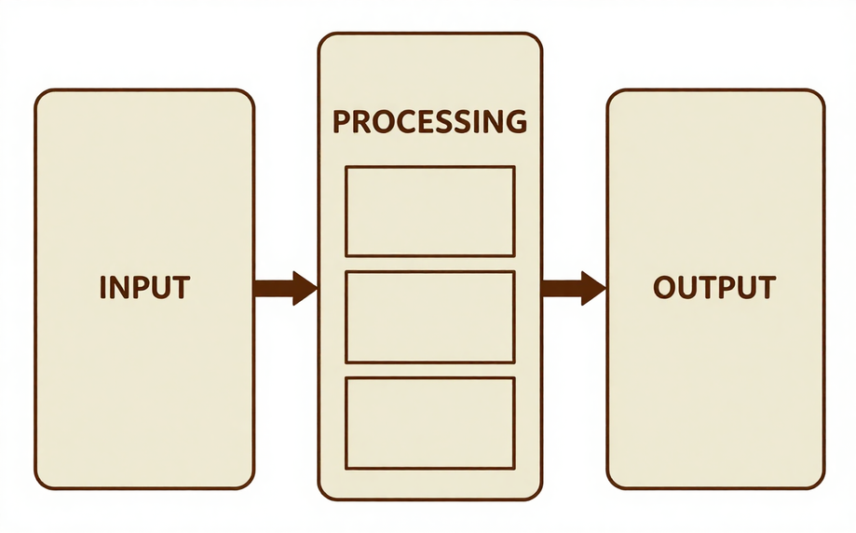
SYSTEM ARCHITECTURE / BLOCK DIAGRAM
Conceptual system flow for traffic congestion analysis and prediction:
• Input: Vehicle traffic dataset (Vehicle_Count, Speed, Weather, Traffic_Density, Time_of_Day, etc.)
• Processing: Data Preprocessing → Feature Extraction → Model Building
• Output: Congestion level prediction and traffic insights
Data flows from raw CSV input through cleaning and normalization, then feature selection identifies key congestion indicators, and the model module produces congestion level classifications (Low / Medium / High).

Slide 9
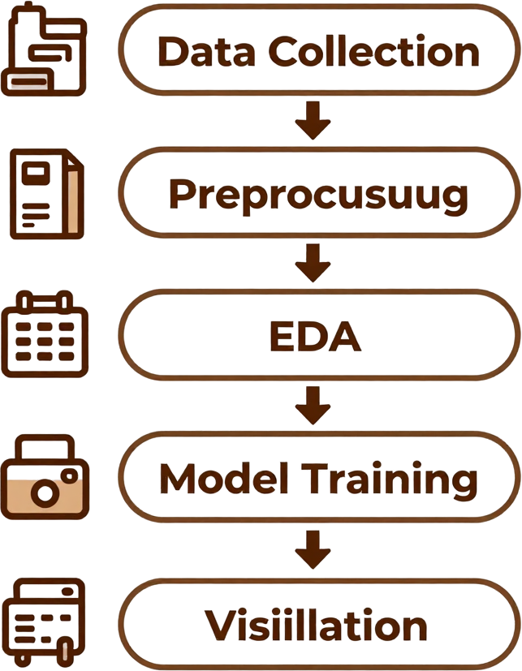
METHODOLOGY & WORKFLOW
Step-by-step project workflow:
• Data Collection: Import vehicle traffic dataset (CSV) and review structure
• Data Preprocessing: Handle missing values, remove outliers, normalize features
• Exploratory Data Analysis (EDA): Compute statistics, visualize distributions and correlations
• Feature Selection & Engineering: Identify key attributes correlated with congestion level
• Model Selection & Training: Choose and apply classification algorithm (placeholder)
• Result Visualization & Interpretation: Generate charts, evaluate patterns, and summarize findings

Slide 10



TECHNOLOGY STACK
Programming Language: Python (proposed) — used for data analysis, visualization, and model building.
Libraries: Pandas & NumPy (data handling), Matplotlib (visualization), Scikit-learn (machine learning).
Database / Data Source: CSV flat file — the vehicle traffic dataset (500 records).
Hardware: Standard PC or cloud-based environment (no specialized hardware required).

Slide 11

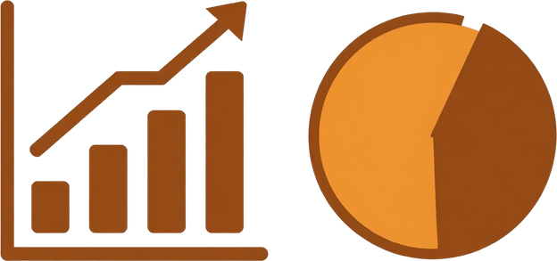
SYSTEM MODULES
Data Collection Module
Import and clean the vehicle traffic dataset (CSV). Remove duplicates and handle missing or inconsistent entries to ensure data quality before processing.
Data Preprocessing Module
Normalize numeric features (Vehicle_Count, Speed, Density). Encode categorical variables (Weather, Road_Type, Day_Type). Prepare data for analysis and model input.
Analysis Module
Generate statistical summaries and exploratory visualizations. Identify correlations between traffic features and congestion levels using charts and descriptive statistics.
Prediction Module
Placeholder for model training and inference. Intended to apply supervised classification (e.g., Decision Tree, Random Forest) to predict congestion levels from input features.
Visualization Module
Produce charts, histograms, and reports summarizing findings. Display congestion class distribution, traffic density trends, and volume-speed relationships for interpretation.
Each module operates sequentially, forming a complete pipeline from raw data input to actionable traffic congestion insights and predictions.

Slide 12
IMPLEMENTATION
• Data analysis is planned using Python along with libraries such as Pandas, NumPy, and Matplotlib.
• Exploratory Data Analysis (EDA) steps have been outlined but are currently in progress.
• Model training and evaluation are proposed steps; no trained model has been developed yet.
• Code snippets and screenshots are to be added in future development phases.
• Preprocessing routines (handling missing values, normalization) are identified but pending implementation.
• Placeholder: Code output and result screenshots will be included here upon completion of development.

Slide 13

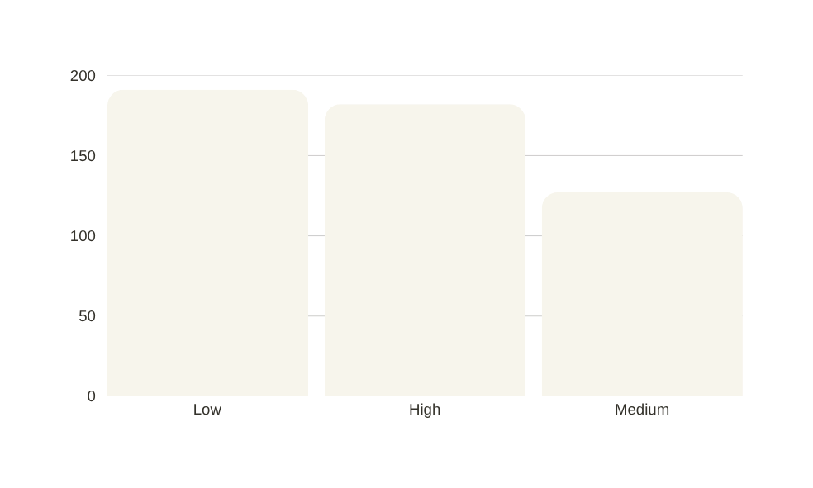
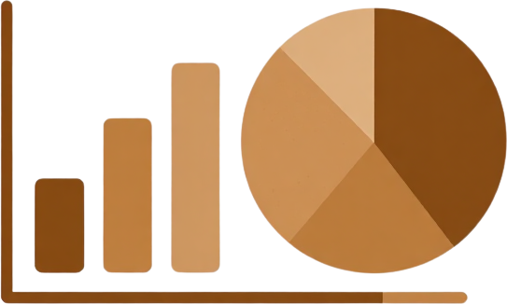
DATASET / INPUT DATA
Dataset Size: 500 records, 9 features
Avg Vehicle_Count: 278.47 | Avg Speed: 44.61
High Congestion Cases: 36.4% of dataset
Features: Vehicle_Count, Avg_Speed, Traffic_Density, Weather, Time_of_Day
Also: Road_Type, Day_Type, Accident, Congestion_Level

Slide 14
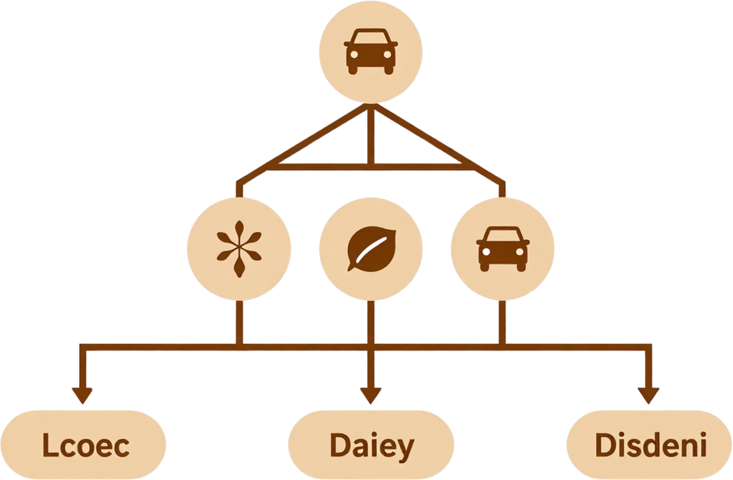
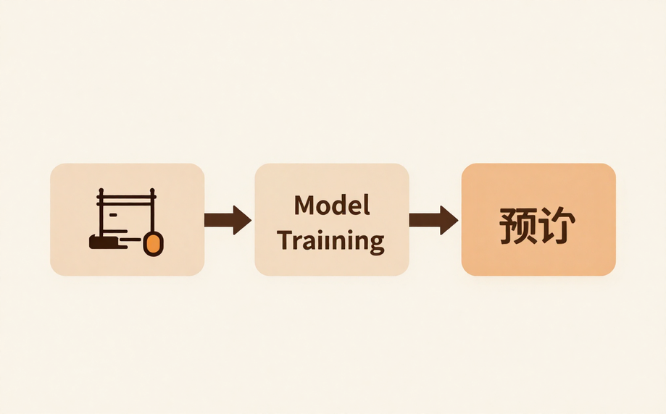
ALGORITHM / MODEL
• Supervised learning for congestion prediction (classification task).
• Potential algorithms:
– Decision Trees: Simple, interpretable rules for congestion levels.
– Random Forest: Ensemble method for improved accuracy.
– Logistic Regression: Baseline binary/multi-class classifier.
• Feature selection based on attributes correlated with congestion (Vehicle_Count, Speed, Density, Weather, Time_of_Day).
• Dataset split into training and testing sets for model evaluation.
• Actual model development and performance metrics are pending future work.

Slide 15
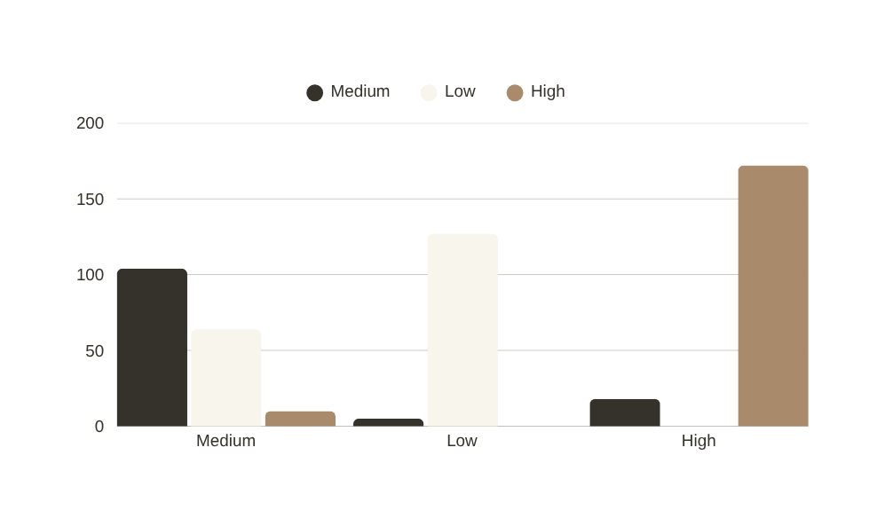
RESULTS
Vehicle_Count vs Speed correlation: -0.90 (strong inverse)
Higher traffic density strongly linked to High congestion
Weather, Time of Day & Road Type affect congestion levels
Accidents and Day Type show notable congestion variation
Model evaluation metrics pending future work

Slide 16
SCREENSHOTS / DEMO
Current Status: No screenshots or live demo are available at this stage of the project.
[ Placeholder: System Interface Screenshot ]
Future addition — user interface for data input and congestion prediction output.
[ Placeholder: Prediction Output Screen ]
Future addition — model prediction results displayed with congestion level labels.
[ Placeholder: Visualization Dashboard ]
Future addition — charts and reports generated from the analysis module.
Note: All placeholders above will be replaced with actual screenshots and demo outputs in future development phases.

Slide 17
ADVANTAGES
Data-Driven Understanding
Analyzing real traffic data provides deeper insights into congestion patterns, helping identify key contributing factors such as vehicle count, speed, and weather conditions more accurately than manual methods.
Early Congestion Prediction
The proposed system enables proactive identification of congestion before it worsens, allowing traffic authorities to take timely action and reduce delays, pollution, and accident risks for commuters.
Scalable & Extensible
The system can be extended for real-time monitoring using live sensor data, and supports informed decision-making for city planners by providing actionable traffic insights and alert mechanisms.

Slide 18



APPLICATIONS
The traffic congestion analysis system has several practical real-world deployment areas:
• Urban Traffic Control Centers: Assist operators in monitoring and managing city-wide traffic flow in real time.
• Navigation & Route Optimization Apps: Provide drivers with congestion-aware routing to reduce travel time.
• City Infrastructure Planning: Support planners with data insights for road expansion and signal optimization.
• Emergency Response & Accident Management: Enable faster emergency routing by identifying congestion hotspots.

Slide 19

LIMITATIONS
Dataset is limited to only 500 records, which may not capture diverse traffic patterns. Larger and more varied datasets are required for building robust and generalizable models.
No real-time or live traffic data integration is available. The system currently relies solely on a static CSV dataset, limiting its applicability to dynamic, real-world traffic conditions.
Model development and validation are pending future work. Additionally, external factors such as road works, events, and construction are not captured in the dataset, reducing prediction accuracy.

Slide 20

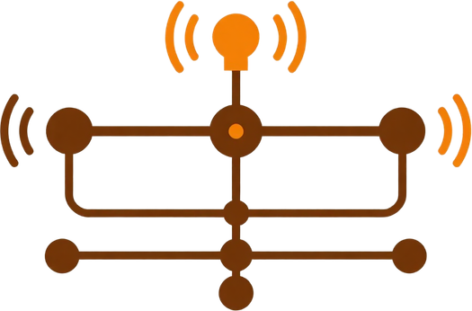
FUTURE SCOPE
Data & Models
• Collect larger, more diverse traffic datasets for robust analysis.
• Develop and train supervised ML models (Decision Tree, Random Forest).
• Validate model accuracy with real-world traffic benchmarks.
• Incorporate historical trend data for better predictions.
Real-Time Integration
• Integrate real-time traffic sensors and IoT devices.
• Enable live data ingestion and dynamic congestion alerts.
• Connect with GPS and navigation APIs for live routing.
• Support automated incident detection and response.
Dashboards & Analysis
• Build user-friendly monitoring dashboards for planners.
• Visualize congestion trends with interactive charts.
• Explore multi-modal traffic including pedestrian flow.
• Support city-wide infrastructure and policy decisions.

Slide 21



THANK YOU

